Slide 1
Rock Paper Scissors
By Brian Dawson and Joshua Annandsingh
ELC 343 - Microcomputer Systems
12/6/19
Notes:
Brian

Slide 2
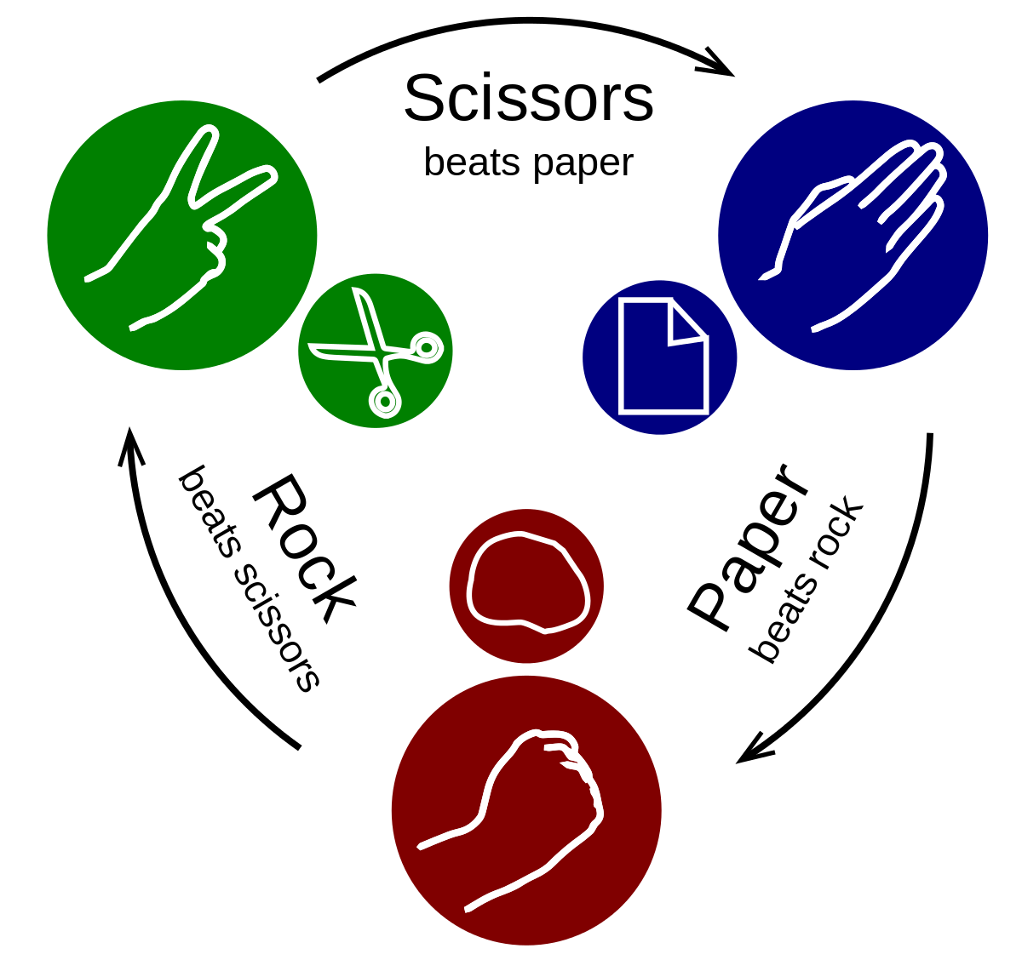
Introduction/Goals
Project: Rock Paper Scissors Game
Two game modes
Single player (vs AI)
Two player
Includes countdown
Restart functionality
Button to choose
Goals
Create successful game with correct logic
Implement seven segment display for countdown
Include AI for single player
Use Capsense for restarting of game
Notes:
Brian

Slide 3
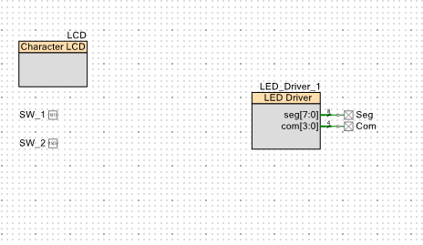
Block Diagram
Notes:
Josh

Slide 4
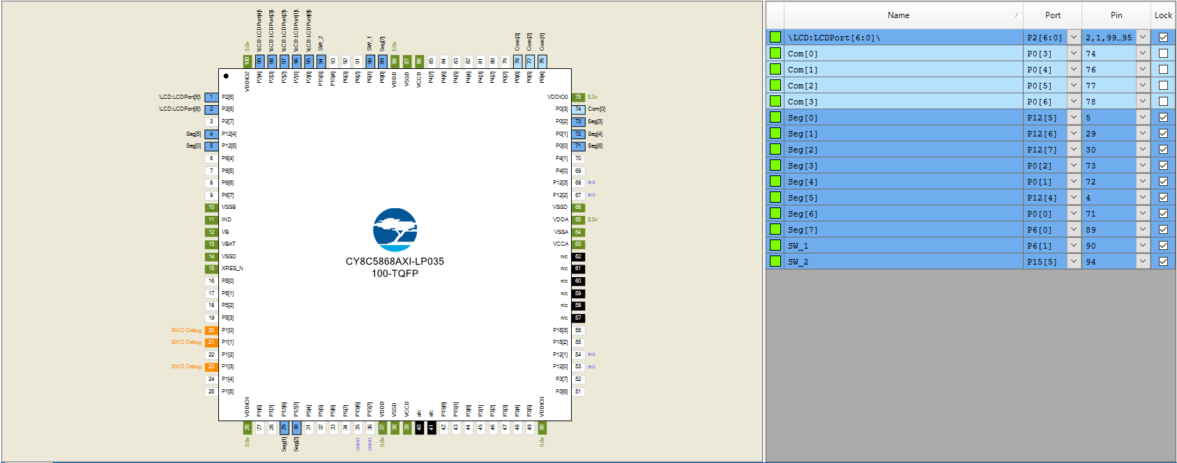
Pins
Notes:
Josh

Slide 5
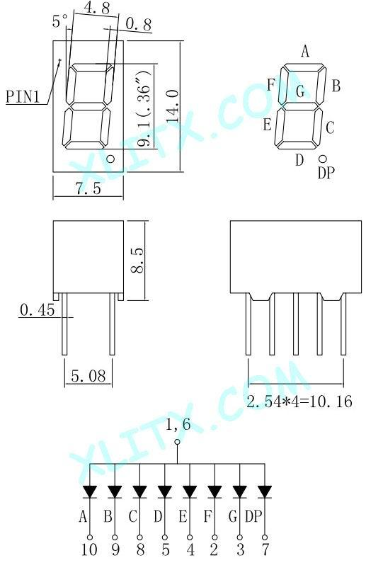
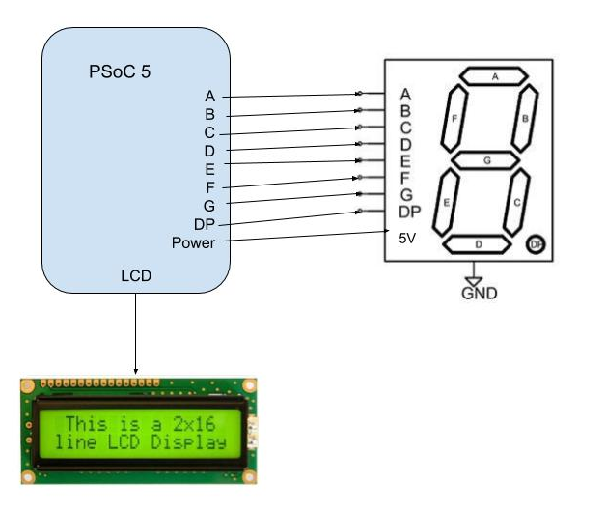
Project Diagram/Devices Used
PSoC CY8CKIT-050 kit
Character LCD
Seven Segment Display
330 Ohm Resistors
Notes:
Brian

Slide 6
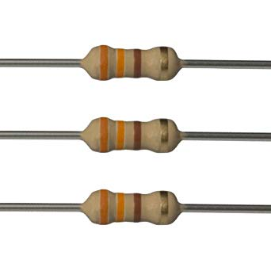
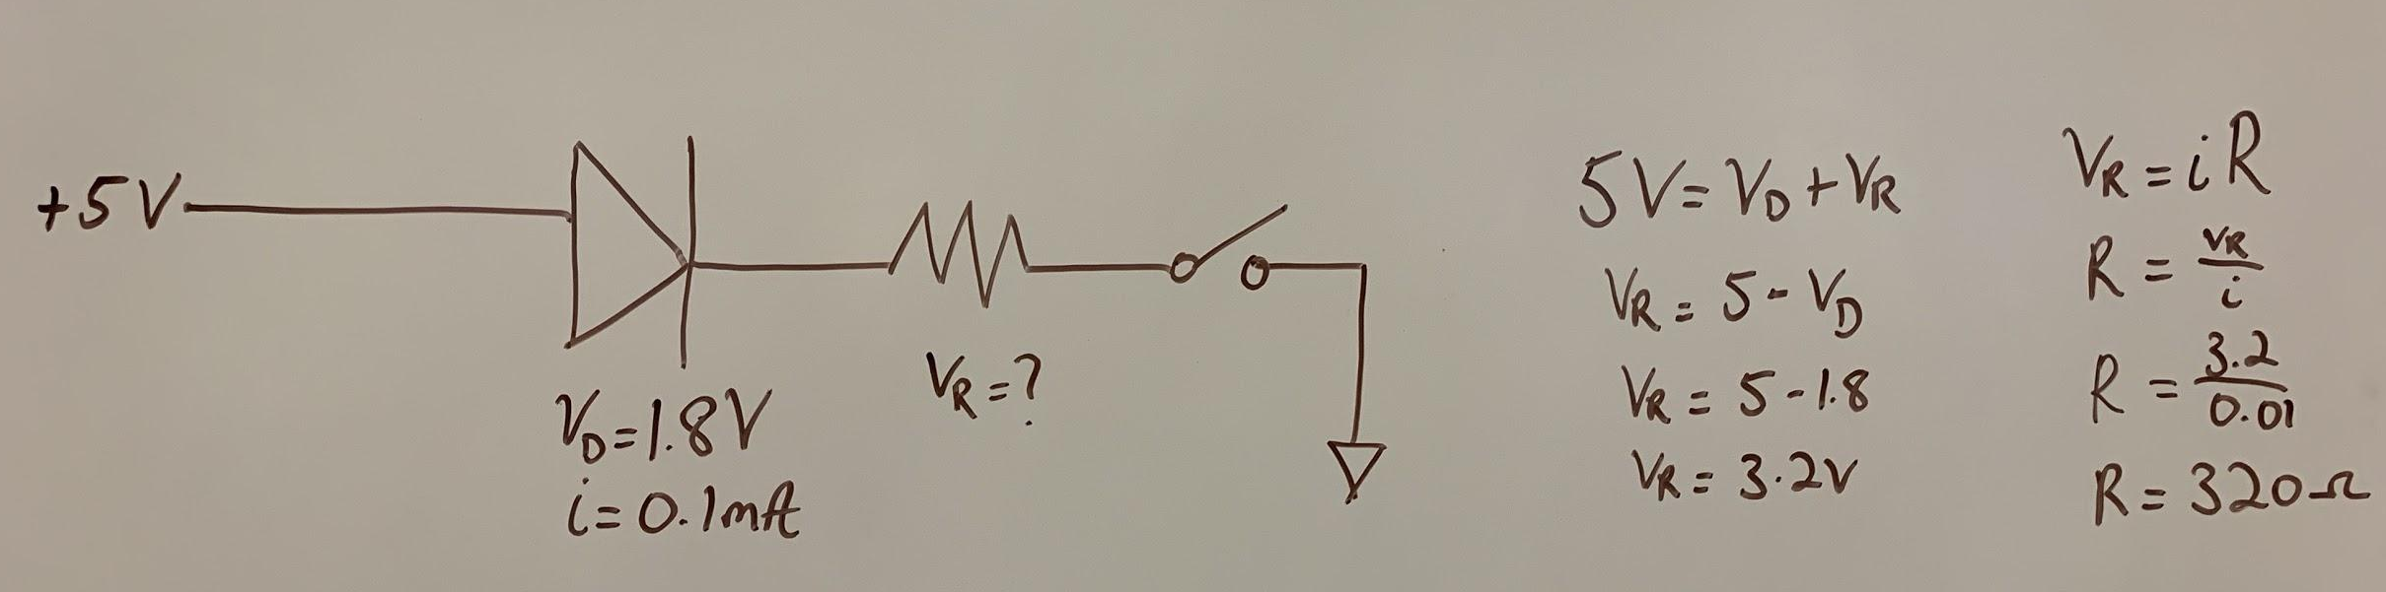
Design Choices
Seven Segment Display
320 Ohm calculated
330 Ohm resistor used
Notes:
Brian

Slide 7
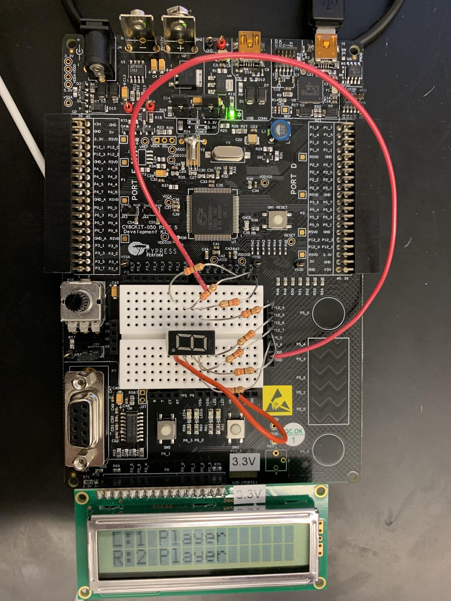
Final Circuit Design
Notes:
Josh

Slide 8
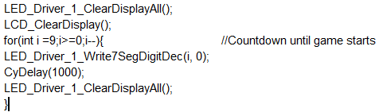
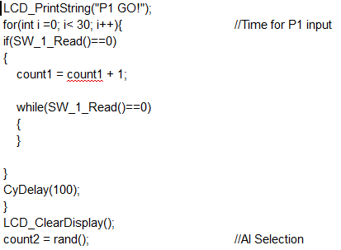
Code Segments
Seven Segment Countdown
Single Player Selection
Notes:
Josh

Slide 9
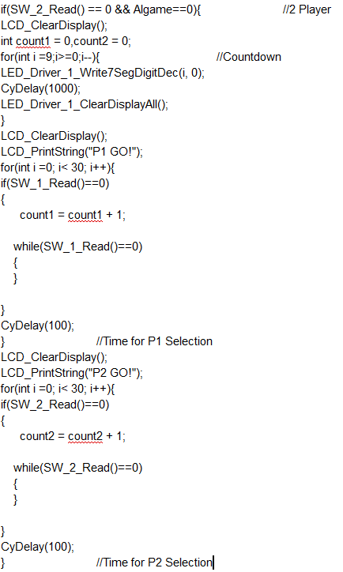
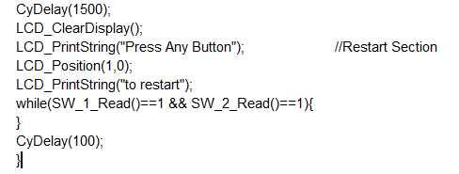
Code Segments 2
Two Player Selection Code Segment
Restart Code Segment
Notes:
Josh

Slide 10
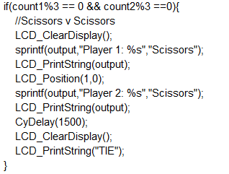
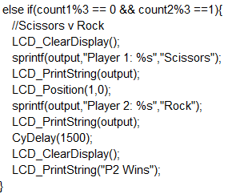
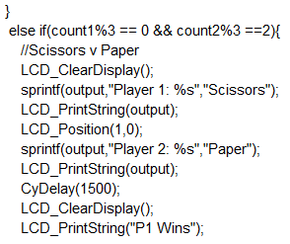
Code Segment 3
Game Logic Code Segments
Notes:
Josh

Slide 11
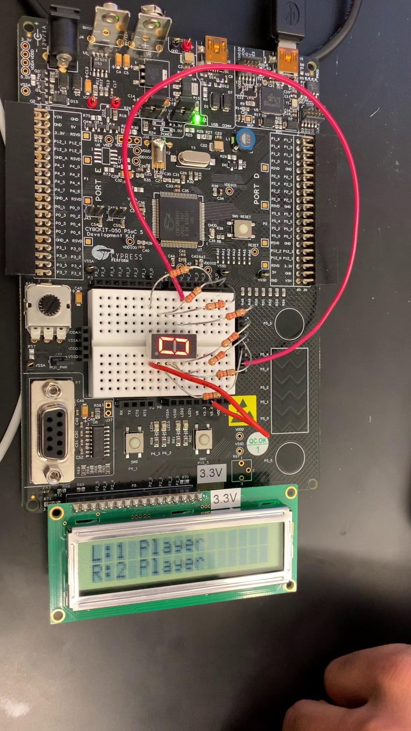
Video
Notes:
Brian

Slide 12

Debug Experiences
Game Logic
Making the two game modes
Singleplayer: AI
Two player: Two buttons
Allowing for multiple button presses
Restart game with button
Seven Segment Display
Using correct resistors
Finding the correct pins
Capsense
Goal to use as restart
Ran into numerous bugs and problems
Notes:
Brian

Slide 13

Conclusions
Learned about
Seven Segment Display
Capsense
Differently next time
Get Capsense working
Develop Further
More advanced Display or multiple seven segments
Expand game into multiple rounds
Do more than just rock paper scissors
Notes:
Brian

